Slide 1
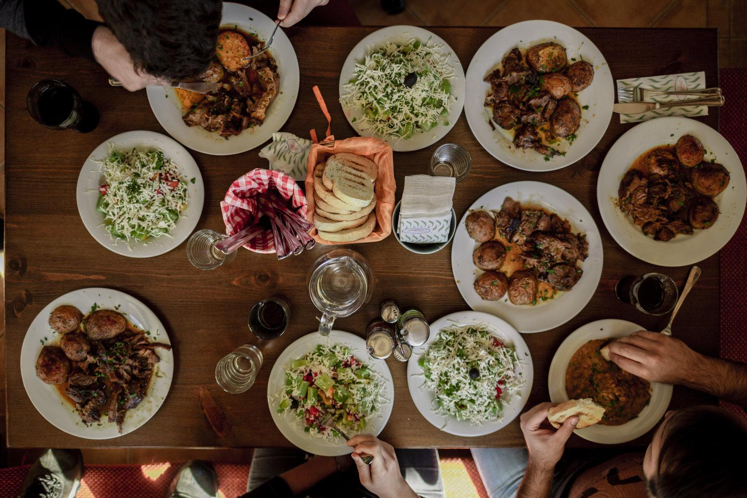
Zomato Project
By Ankit Singh

Slide 2
Zomato Project
By Ankit Singh

Slide 3

About Zomato:-
Zomato is a leading restaurant search and discovery platform founded in 2008 in India. It allows users to find restaurants, read reviews, and order food for delivery. Zomato is a pioneer in the Indian market and now operates globally with over 1 million listed restaurants across 24 countries. It has received hundreds of millions in funding from investors and has grown through acquiring other food-related companies.

Slide 4
How Zomato Works
Zomato has been rapidly growing since 2008 and is one of the most successful startups in India. Even well-established business owners and entrepreneurs are excited to know how it works and how it generates huge profits even after offering attractive discounts.
The main work of Zomato is to suggest local and nearby restaurants to users and receive orders from them. Users can place orders from their favorite restaurant based on ratings and reviews shared by previous customers. Perhaps this is why more and more startup owners are interested in developing an app similar to Zomato.
It offers comfort to the users and helps business owners reach their local food business to new heights. Zomato’s workflow is simple; let’s see how, within a few minutes, consumers can enjoy a delicious meal.

Slide 5
In this Zomato project
In this Zomato project, I conducted a deep analysis of Zomato's data, which included various restaurant names from different countries. I performed numerous tasks on the data, utilizing aggregation functions, pivot tables, and charts to generate valuable insights. After thorough analysis, I identified optimal locations in eight different countries where new restaurants should be established.
Additionally, I created a comprehensive dashboard to present these findings, enabling the management to understand the analysis results and make informed decisions based on the data.
I would like to thank Newton School for providing me with such great opportunity to implement my Spreadsheet knowledge into real life problems and come up with useful insights.

Slide 6
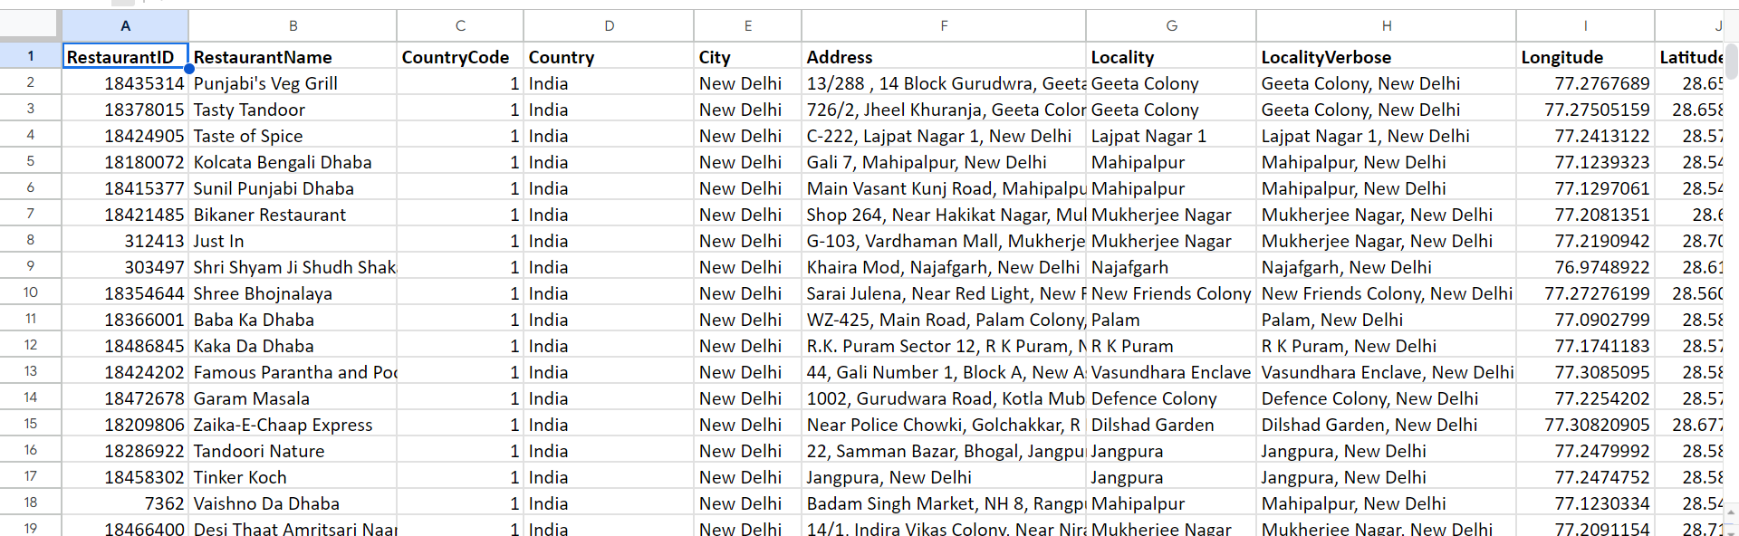
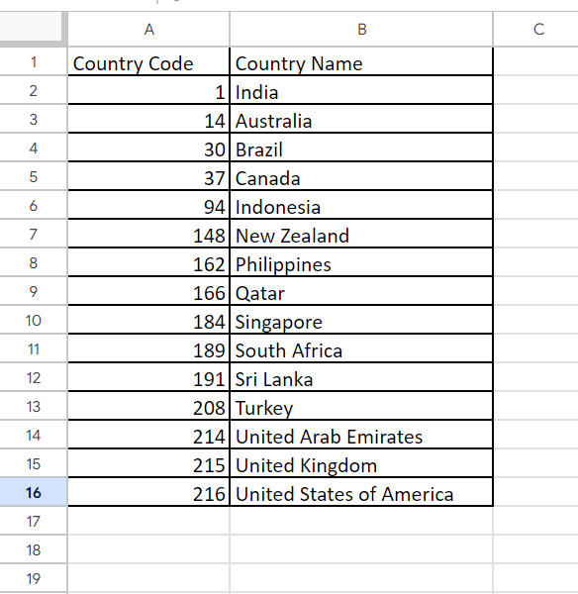
Objective Question
Task 1- What is the total no. of tables present in the data?
Ans. There are 2 tables present in the given data (Raw Data, Country Description).

Slide 7
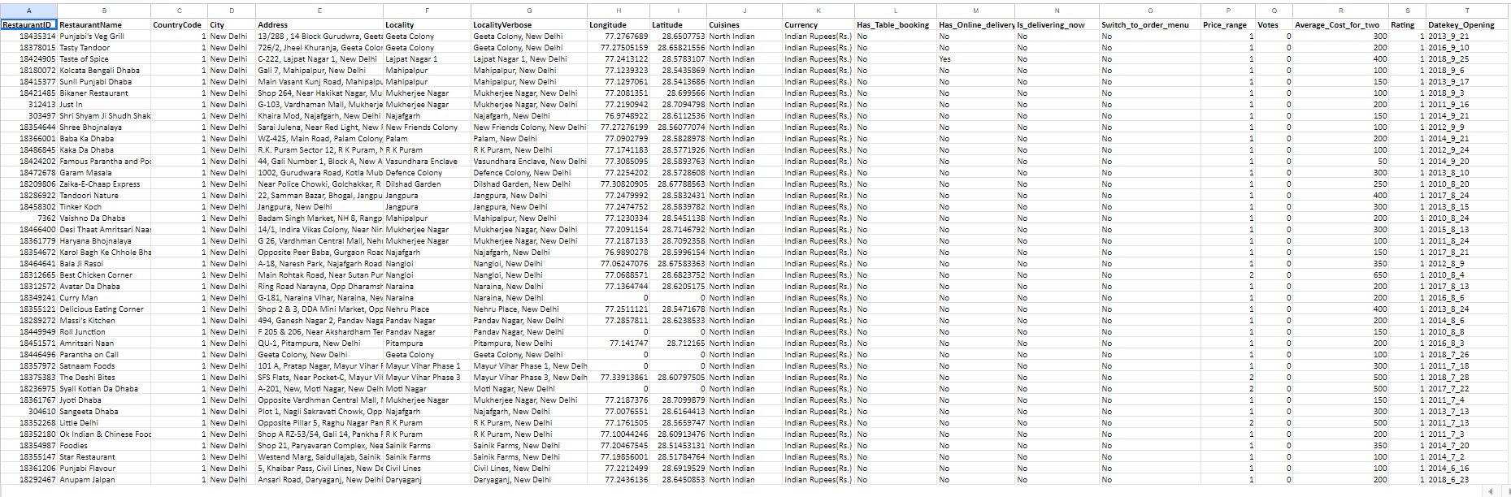
Task. 2 What is the total no. of attributes present in the data?
Ans. There total 20 attributes present in the data (Restaurant ID, Restaurant Name, Country Code, City, Address,Locality, Locality verbose, Longitude,Latitude, Cuisines,Currency, Has_Table_booking, Has_online_delivery, Is_delivering_now, Switch_to_order_menu, Price_range, Votes, Average_cost_for_two, Rating, Datekey_Opening)

Slide 8
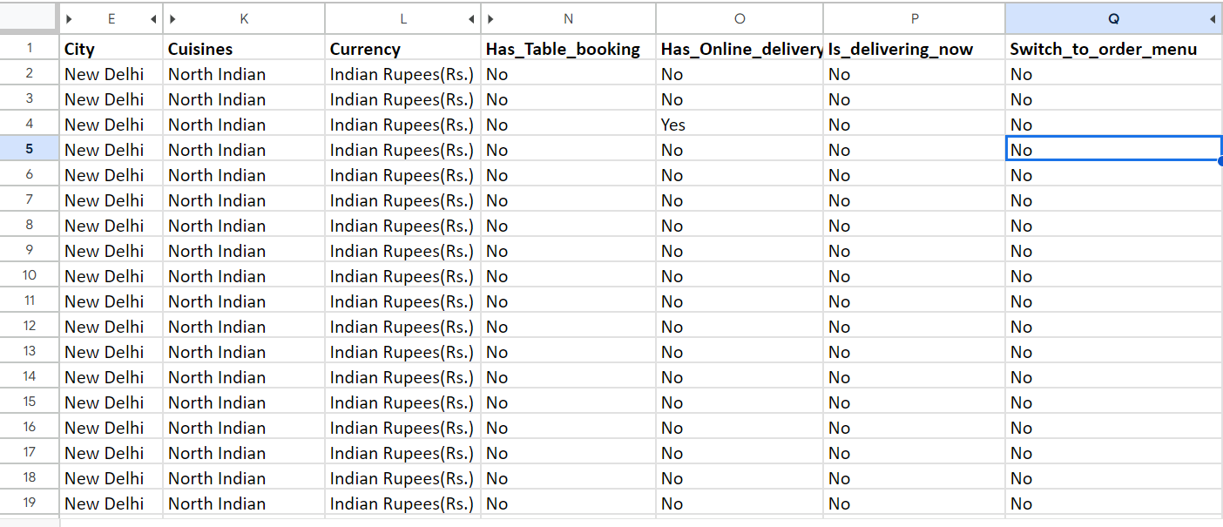
Task 3. How many categorical columns are there in the data?
Ans. There are 7 categorical columns in the data (City, Cuisines, Currency, Has_Table_booking, Has_online_delivery, Is_delivering_now, Switch_to_order_menu).

Slide 9
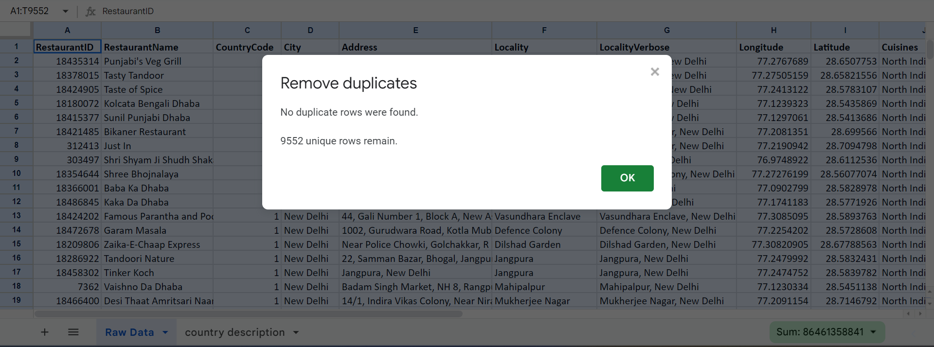
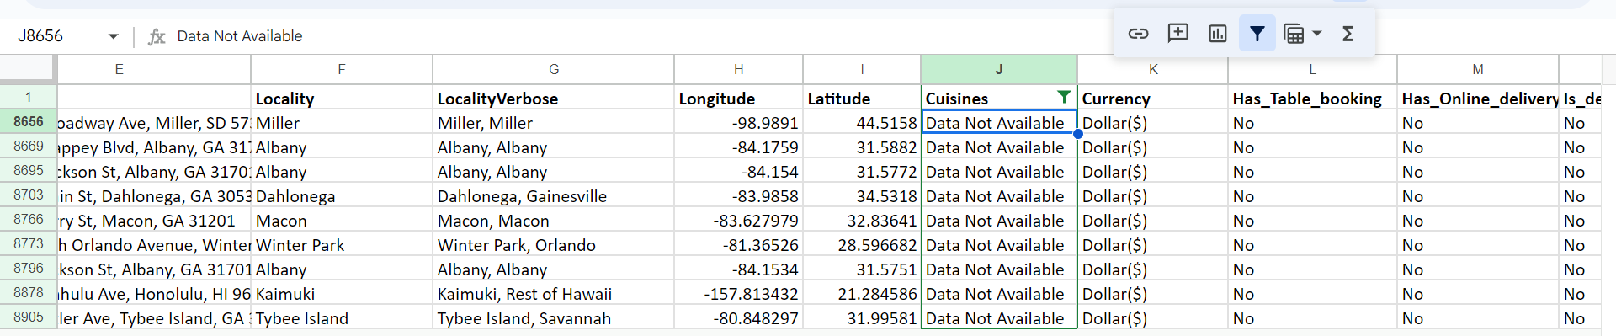
Task 4. The data consists of some inconsistent and missing values so ensure that the data used for further analysis is cleaned.
Ans. Cleaned the data by removing ‘Duplicates’ and filled “Data Not Available” in blank cells.

Slide 10
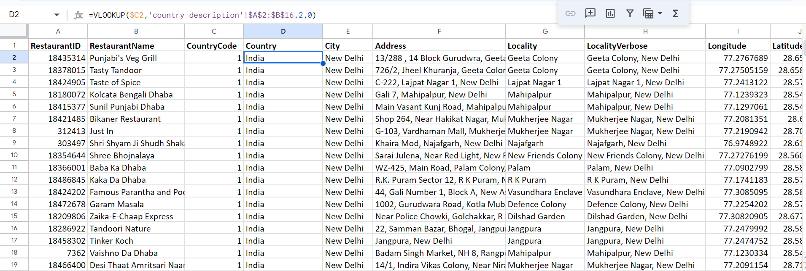
Task 5. Using the LookUp functions, fill up the countries in the original data using the country code.
Ans. Used the Vlookup function =VLOOKUP($C2,'country description'!$A$2:$B$16,2,0), to fill up the countries in original data using country code from country description.

Slide 11
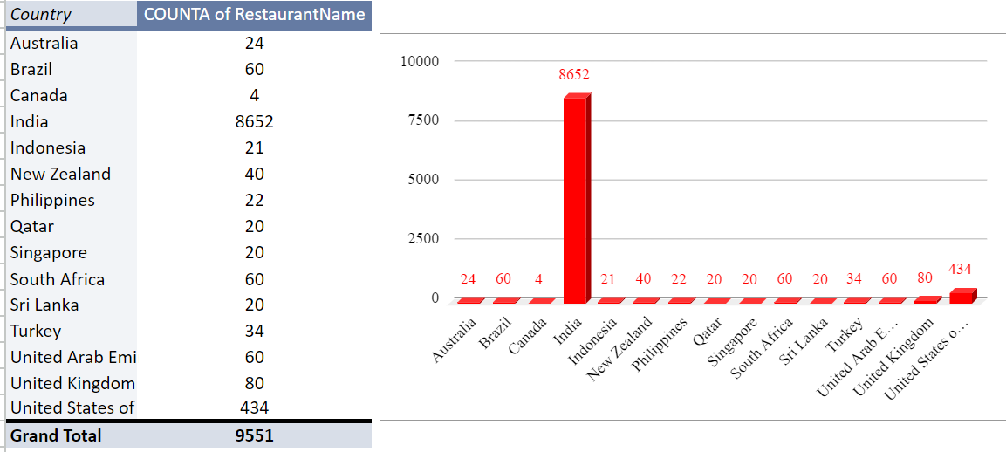
Task 6. Create a table to represent the number of restaurants opened in each country.
Ans. The following table was created Representing number of Restaurants opened in each Country.

Slide 12
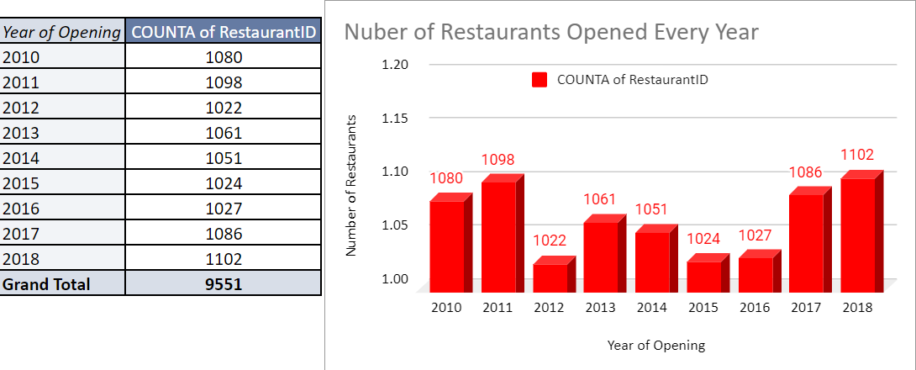
Task 7. The management wants to look at the number of restaurants opened each year, so provide them with something here.
Ans. Below table and chart represents Number of Restaurants per Year.

Slide 13
Task 8. What is the total number of restaurants in India in the price range of 4?
Ans. Total number of restaurants in India in the price range of 4 is 344.

Slide 14
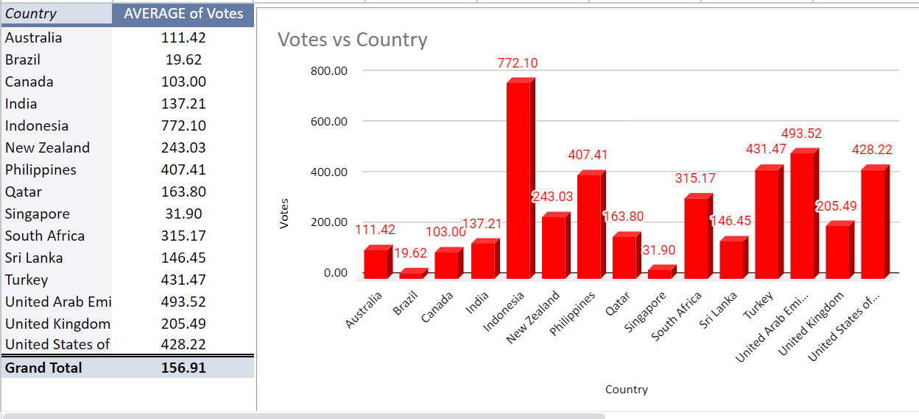
Task 9. What is the average number of voters for the restaurants in each country according to the data?
Ans. Below table and Chart shows the Average Voters for the restaurants in each country.

Slide 15

Task 10. Calculate the average rating for all the restaurants that have price_range < 4 and provide online delivery. Use only the “IF” function, Logical Operators, and Aggregation functions to solve this problem
Ans. Average rating for all the restaurants that have price_range < 4 and provide online delivery is 3.27.

Slide 16
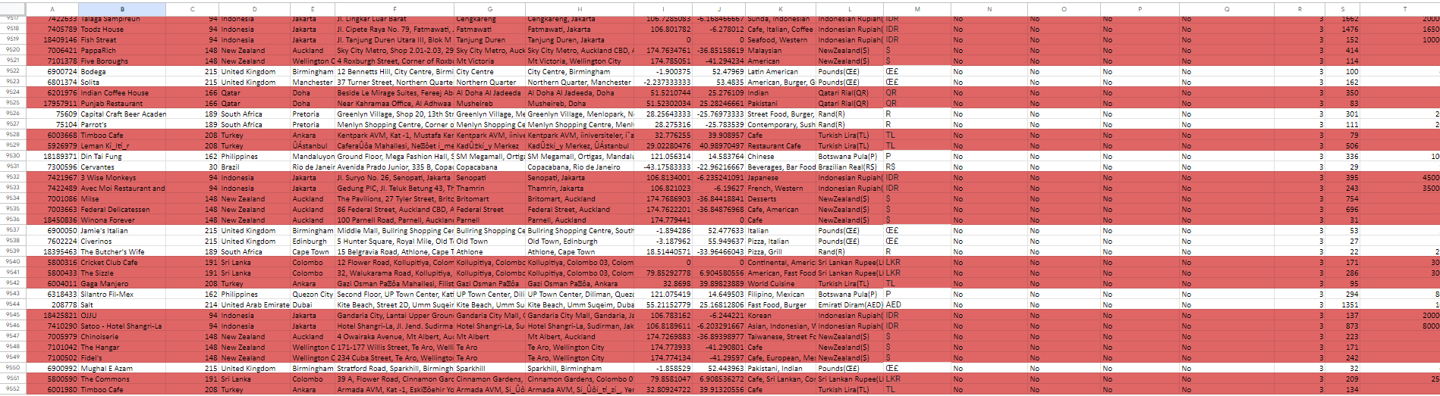
Task 11. Using Conditional formatting highlight the rows of restaurants that are located in the countries or cities that you’ve suggested to the management for opening new restaurants.
Ans. Used Condition formatting for highlighting the rows of restaurants that are located in the countries and cities that we’ve suggested for opening new restaurants by first creating an additional column named Suggested Country/City Yes/No for marking suggested Countries and cities as “Yes” and others as “No” and then using formula (=$Z$2:$Z="Yes") for applying Conditional formation.

Slide 17
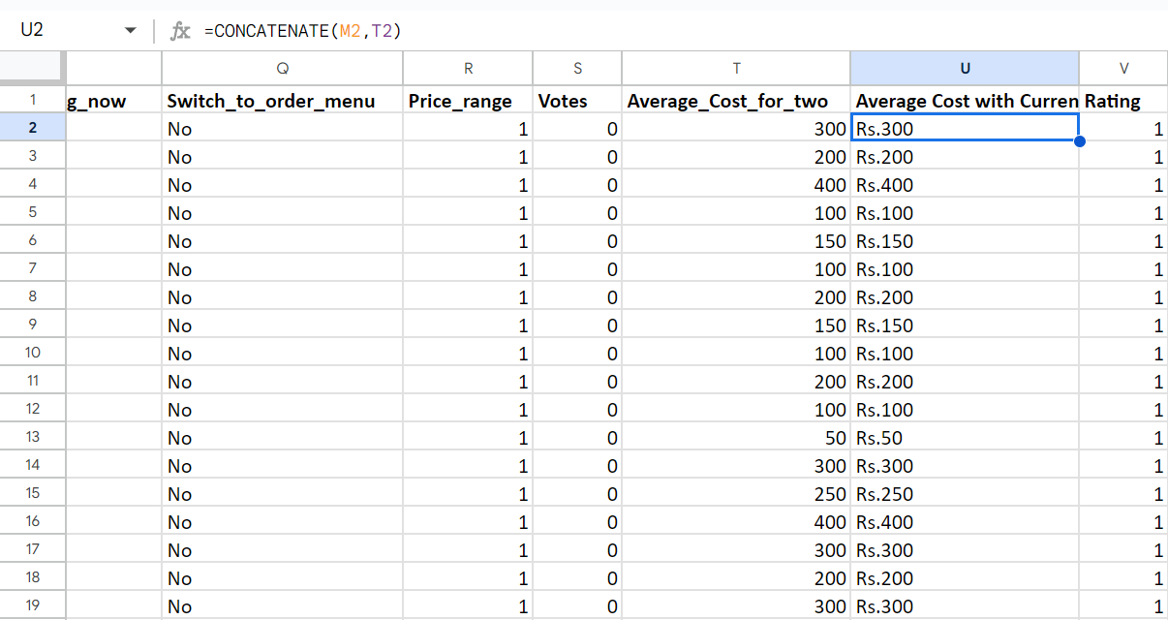
Task 12. Create a new customized price column that consists of the abbreviation/symbol of the currency along with the Average_cost_for_two value
Ans. . Created a new customized column for symbols with respective country from “Currency” column as “M” using =REGEXEXTRACT(L2, "\((.*?)\ function then created price column as Column U that consists of symbol of the currency along with the Average_cost_for_two using formula =CONCATENATE(M2,T2).

Slide 18
Task 13. How can you create an array formula in Excel or Google Sheets to count the number of restaurants listed that do not offer online delivery, are in the lowest price range, and have an average cost for two people less than or equal to 250 Indian Rupees?
Ans. We created an Array formula to count the number of restaurants listed that do not offer online delivery, are in the lowest price range, and have an average cost for two people less than or equal to 250 Indian Rupees using Countifs functions taking Criteria_range1 as Country column and set “India” as Criterian1 and Criteria_range2 as Has_online_delivery and setting “No” as Criterian2 and Criteria_range3 as Price_range setting Criterian3 as 1 and Criteria_range4 as Average cost for two setting “<=250” as Criterian4 and then marking this formula as an Array Formula resulting in following function =ArrayFormula(COUNTIFS('Raw Data'!D2:D,"India",'Raw Data'!O2:O,"No",'Raw Data'!R2:R,"1",'Raw Data'!T2:T,"<=250")).

Slide 19
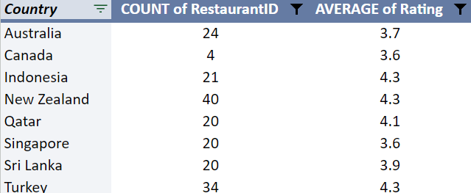
Subjective Questions
Task 1. Suggest a few countries where the team can open newer restaurants with lesser competition. Which visualization/technique will you use here to justify the suggestions?
Ans. Below table shows the suggested countries to open new restaurants with lesser competition .

Slide 20
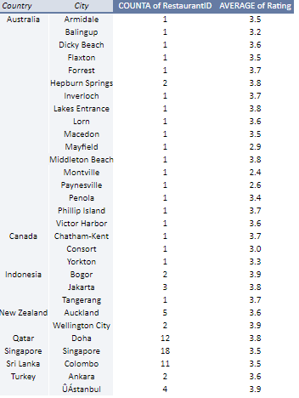
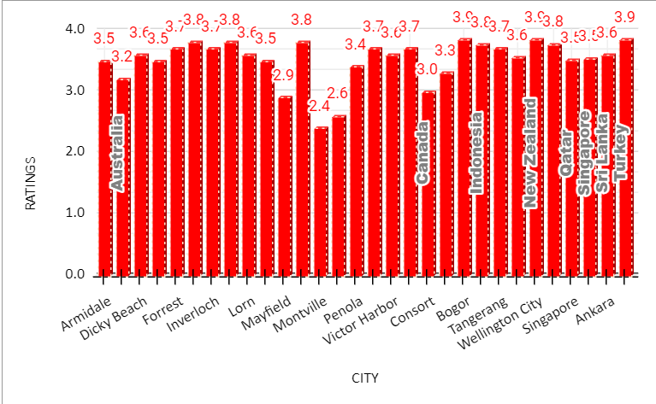
Task 2. Come up with the names of States and cities in the suggested countries suitable for opening restaurants.
Ans. Below table and chart shows the name of States and Cities in the suggested countries suitable for opening New Restaurants. Filtered where the Average Ratings is Less than and equal to 4.

Slide 21
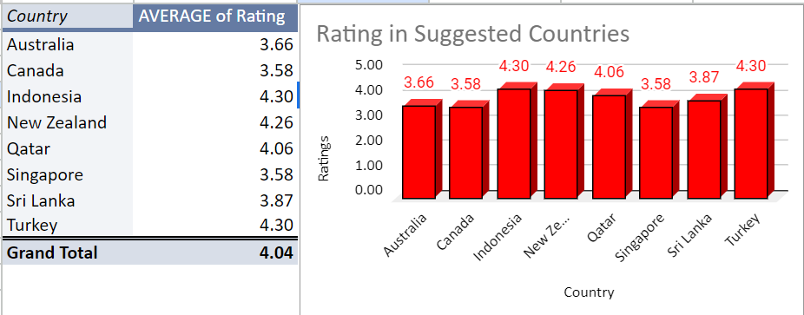
Task 3. According to the countries you suggested, what is the current quality regarding ratings for restaurants that are open there?
Ans. Above Table shows the current Average Ratings of Restaurants in the Suggested Countries. We can see that the Average Rating for all the suggested countries are More than 3 so we can say that the Quality regarding ratings are Good.

Slide 22
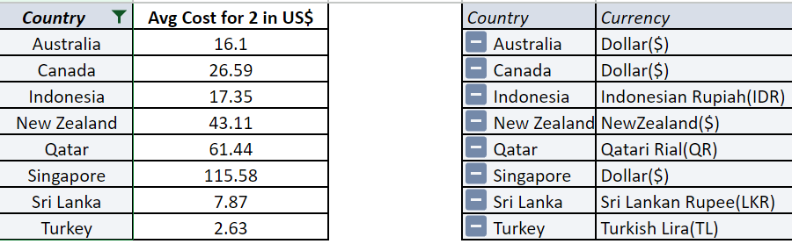
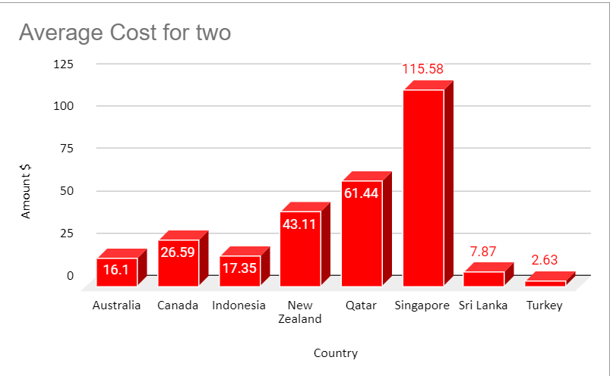
Task 4. What is the current expenditure on food in the suggested countries, so we can keep our financial expenditure in control?
Ans. The below tables and charts shows the Current expenditure on food in the suggested countries in US Dollars along with a separate table showing the original currencies of the respected countries.

Slide 23
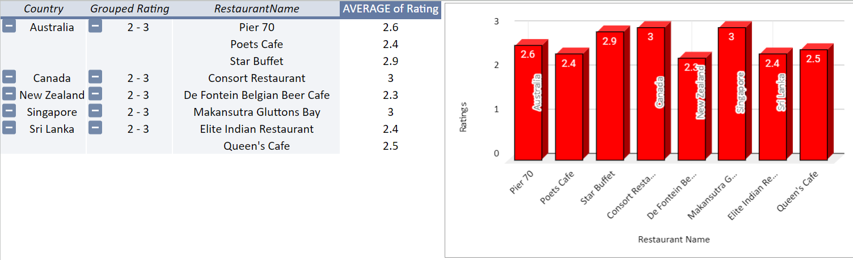
Task 5. Come up with the names of restaurants from the recommended states that are our biggest competitors and also those that are rated in the lower brackets, i.e. 1-2 or 2-3.
Ans. The below table and charts shows the name of the Restaurants from the recommended states that are our biggest competitors and also whose ratings are between 1-3.

Slide 24
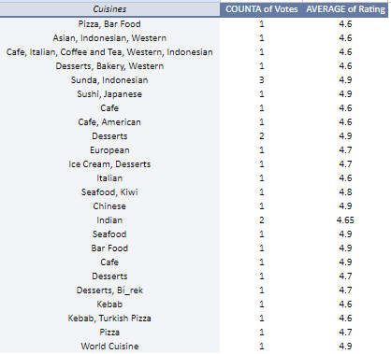
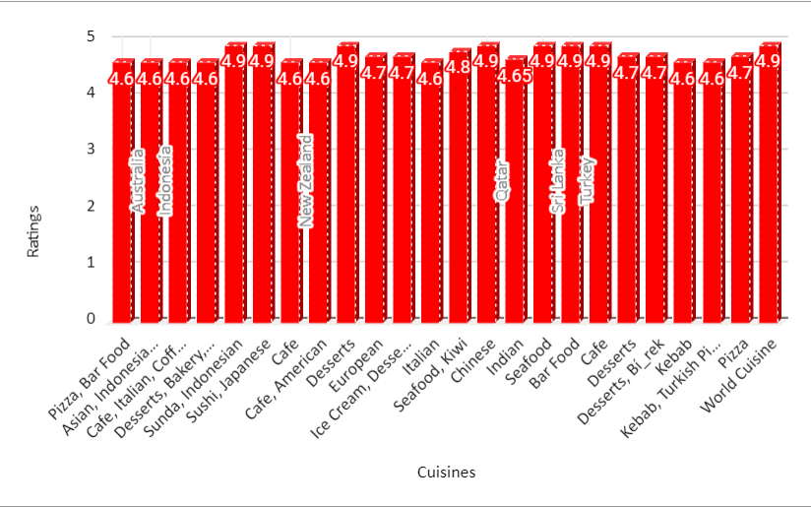
Task 6. Which cuisines should we focus on in the newer restaurants to get better feedback? Does the choice of cuisines affect the restaurant ratings?
Ans. The folowing table and chart shows the name of Cuisines having Ratings more than 4.5 that we should focus on in the newer restaurants in the suggested countries for better feedback.

Slide 25
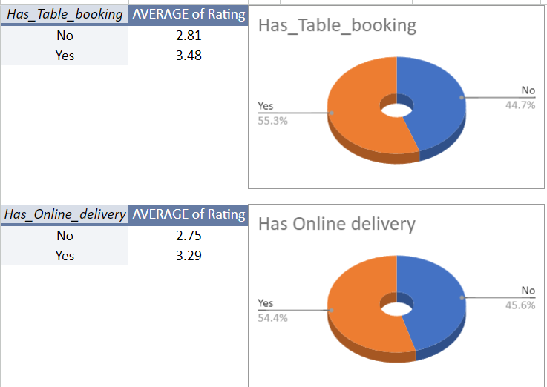
Task 7. According to our current data, should we go for online delivery and table booking? Does that affect the customer’s ratings?
Ans. The following tables and charts show the Average Ratings for the Has_Table_booking as well as Has_Online_delivery. Here we can clearly see the average rating in both the tables are greater for “Yes”, so with this analysis we can conclude that we should go for the online delivery and table booking option because that will affect the customer’s ratings.

Slide 26
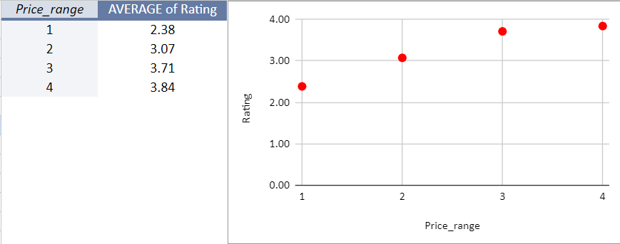
Task 8. Should the team keep the rate of cuisines higher? Will that affect the feedback? According to our data are the rates of cuisines and ratings, correlated?
Ans. The below table and chart shows that Average ratings for every price range . From the above table we can see that the Average rating increases with the rates of cuisines.
So from this analysis we can conclude that We should keep the rate of cuisines higher and that will affect our feedback. Also we can clearly see from the table that the rates of cuisines and ratings are correlated in our data.

Slide 27
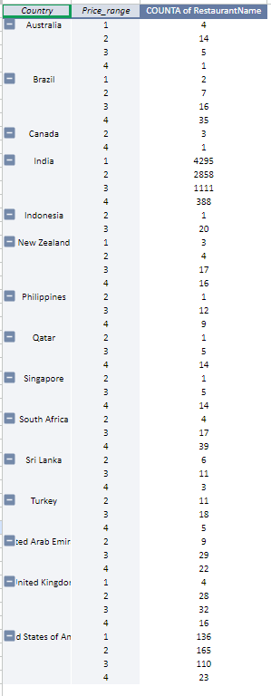
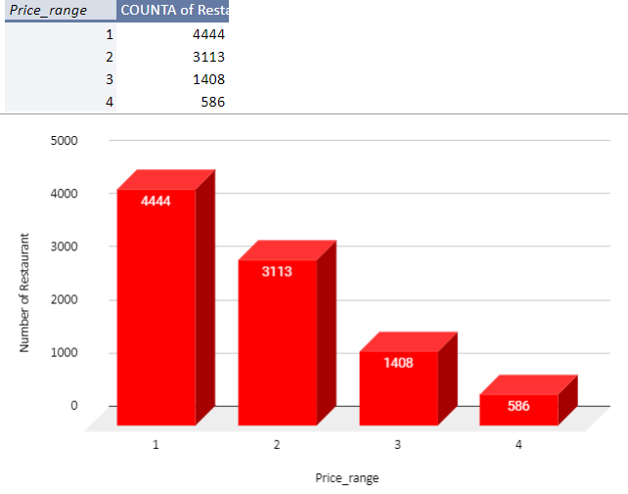
Task 9. What is the distribution of the number of restaurants of different price ranges in all the countries?
Ans. The below tables and chart shows the distribution of the number of restaurants of different price ranges in all the countries.

Slide 28
Task 10. . Explain your approach in brief for suggesting countries/cities in order to open new restaurants, if the objective and subjective questions would have not been given to assist you.
Ans. Approach for suggesting countries/cities in order to open new restaurants.
Look for the places where there are less restaurants with high customer ratings.
Look for cities where people often go out for food and order from restaurants.
Study the cuisines and food preferences for the particular areas.
Select the type of menu and food we want to serve in our restaurant.
Make sure the economic condition of that country is stable and there is no political or societal hindrance.
Checkout the other restaurants that are present nearby and see how we can do different and better in terms of services and dining experience.
Find a suitable location to open new restaurants that should be accessible to the people having amenities like parking

Slide 29
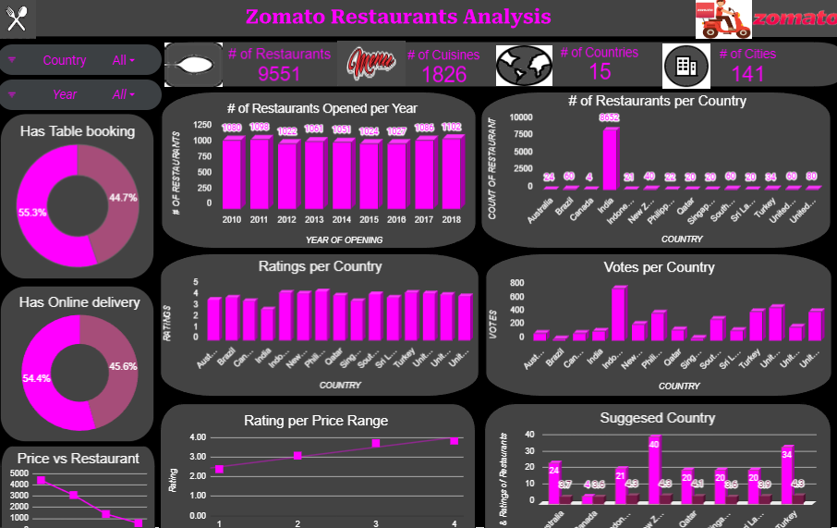
From the above Tasks and Analysis created an interactive dashboard.
Dashboard Link

